Slide 1

ECONOMICS OF TESTING
HOW TESTING IS CONDUCTED?
SOFTWARE TESTING – ( PAST )
SOFTWARE TESTING – ( PRESENT )
SCOPE OF SOFTWARE TESTING
FACTORS INFLUENCING THE SCOPE OF TESTING
RISK BASED TESTING
PROJECT RISK
PRODUCT RISK
NEED OF INDEPENDENT TESTING
ACTIVITIES IN FUNDAMENTAL TEST PROCESS
ATTRIBUTES OF A GOOD TESTER
PSYCHOLOGY OF TESTING
CODE OF ETHICS FOR TESTER
LIMITATIONS OF SOFTWARE TESTING

Slide 2

ECONOMIC OF TESTING

Slide 3
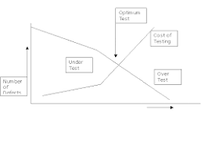
ECONOMIC OF TESTING
There is a definite economic impact of software testing.
One economic impact is from the cost of defects.
This is a very real and very tangible cost.
Another economic impact is from the way we perform testing.
It is possible to have very good motivations and testing goals while testing in a very inefficient way.

Slide 4
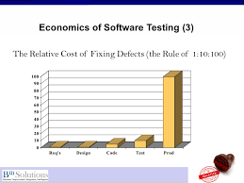
Some problems in getting accurate, clear, and testable requirements are:
Many people do not have a solid requirements gathering process
Few people have been trained in or understand the dynamics of requirements
Projects, people, and the world around us change very quickly
The English language is ambiguous and even what we consider clear language can be interpreted differently by different people.

Slide 5

HOW TESTING IS CONDUCTED?

Slide 6
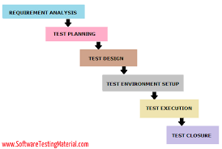
HOW TESTING IS CONDUCTED?
Testing is based on external expectations - Internal behavior of the application is unknown.
Testing is done on the basis of high-level database diagrams and data flow diagrams.
Internal workings are fully known and the tester can design test data accordingly.
Requirement Analysis.
Planning the test.
Developing the test case.
Setting up the test environment.
Executing the test.
End of test, or closing the test cycle.

Slide 7

SOFTWARE TESTING – ( PAST )

Slide 8

SOFTWARE TESTING – ( PAST )
Software testing is the process of evaluating and verifying that a software product or application does what it is supposed to do.
The benefits of testing include preventing bugs, reducing development costs and improving performance.
In olden times there is no must technology is there.
They used to work for long hours to develop.
In past, there is less technology and less members in interest in testing.

Slide 9

SOFTWARE TESTING – ( PRESENT )

Slide 10
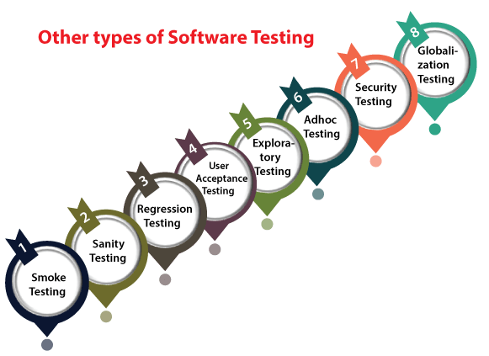
SOFTWARE TESTING – ( PRESENT )
Now a days there are more in testing.
We have more technology in testing process.
And there are more number of people are interested in testing.
Below are the latest trend in testing.
UAT (Acceptance Testing)
DevOps.
Regression Testing.
Automation Testing.
Integration Testing.
User Testing.
Accessibility Testing.
Performance Testing.

Slide 11

SCOPE OF SOFTWARE TESTING

Slide 12
SCOPE OF SOFTWARE TESTING
The Scope Of Software Testing.
Technically, Software Testing is an investigation conducted to provide stakeholders with information about the quality of a particular product or service under test.
In other words, software testing is a process of verification and validation.
To test software, a tester is expected to know the software that is to be tested, plus the tools required to test it.
Often, it can be very specialized, and your employer company may have to train you.
To be a good tester, you need to be very organized, logical, meticulous, thorough, and patient.

Slide 13
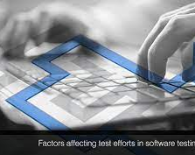
FACTORS INFLUENCING THE SCOPE OF TESTING

Slide 14
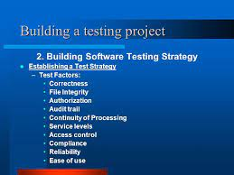
FACTORS INFLUENCING THE SCOPE OF TESTING
There are some influencing factors in the testing:
Correctness.
Negative.
User Interface.
Usability.
Performance.
Security.
Integration.
Reliability.
Planning.
Time.
Size & Complexity.
Documentation.
Skills.
Team interaction.
Methodology.
Trends.

Slide 15
Correctness :
Correctness is the minimum requirement of software, the essential purpose of testing. The tester may or may not know the inside details of the software module under test e.g. control flow, data flow etc.
Negative : In this factor we can check what the product it is not supposed to do. User Interface :
In UI testing we check the user interfaces. For example in a web page we may check for a button. In this we check for button size and shape. We can also check the navigation links.
Usability :
Usability testing measures the suitability of the software for its users, and is directed at measuring the following factors with which specified users can achieve specified goals in particular environments.
Effectiveness :
The capability of the software product to enable users to achieve specified goals with the accuracy and completeness in a specified context of use.
2.Efficiency :
The capability of the product to enable users to expend appropriate amounts of resources in relation to the effectiveness achieved in a specified context of use.

Slide 16
Performance :
In software engineering, performance testing is testing that is performed from one perspective to determine how fast some aspect of a system performs under a particular workload.Performance testing can serve various purposes. It can demonstrate that the system needs performance criteria.
Load Testing:
This is the simplest form of performance testing. A load test is usually conducted to understand the behavior of the application under a specific expected load.
2.Stress Testing:
Stress testing focuses on the ability of a system to handle loads beyond maximum capacity. System performance should degrade slowly and predictably without failure as stress levels are increased.
3.Volume Testing:
Volume testing belongs to the group of non-functional values tests. Volume testing refers to testing a software application for a certain data volume. This volume can in generic terms be the database size or it could also be the size of an interface file that is the subject of volume testing.

Slide 17
Security : Process to determine that an Information System protects data and maintains functionality as intended. The basic security concepts that need to be covered by security testing are the following:
Confidentiality : A security measure which protects against the disclosure of information to parties other than the intended recipient that is by no means the only way of ensuring
Integrity: A measure intended to allow the receiver to determine that the information which it receives has not been altered in transit other than by the originator of the information.
Authentication: A measure designed to establish the validity of a transmission, message or originator. Allows a receiver to have confidence that the information it receives originated from a specific known source.
Integration :
Integration testing is a logical extension of unit testing. In its simplest form, two units that have already been tested are combined into a component and the interface between them is tested.
Reliability :
Reliability testing is to monitor a statistical measure of software maturity over time and compare this to a desired reliability goal.
Compatibility :
Compatibility testing of a part of software's non-functional tests. This testing is conducted on the application to evaluate the application's compatibility with the computing environment. Browser compatibility testing can be more appropriately referred to as user experience testing.

Slide 18

RISK BASED TESTING

Slide 19
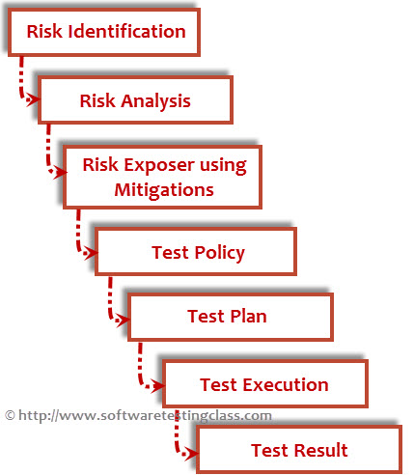
RISK BASED TESTING
Risk-based testing applied to the project at very initial level, identifies risks of the project that expose the quality of the project, this knowledge guides to testing planning, specification, preparation and execution.
Risk-based testing includes both mitigation (testing to give chances to decrease the likelihood of faults, specially high-impact faults) and contingency (testing to know work-around to create the defects that do get past us less painful).
Risk-based testing also includes measurement process that recognizes how well we are working at finding and removing faults in key areas.
Risk-based testing also uses risk analysis to recognize proactive chances to take out or avoid defects through non-testing activities and to help us select which test activities to perform.

Slide 20

PROJECT RISK

Slide 21
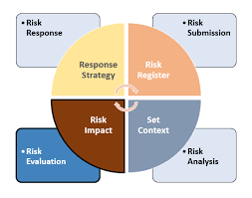
PROJECT RISK
A project risk is an uncertain event that may or may not occur during a project.
Risk management in project management starts with identifying project risks.
There’s no way to account for all possible project risks, so we need to focus on finding the most impactful ones via a few key avenues of research. These include:
Interview stakeholders to find out about risks which have affected the organization or team’s previous projects.
Identify external risks using a situational analysis framework such as PESTEL (Political, Economic, Social, Technological, Environmental, Legal).
Analyze your project planning documentation to identify inherent risks of the project.

Slide 22

PRODUCT RISK

Slide 23
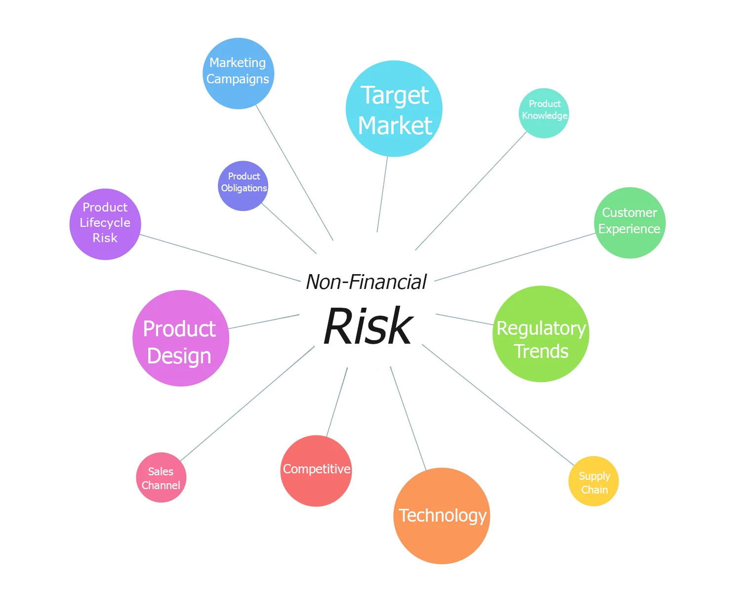
PRODUCT RISK
Product risk is the set of things that could go wrong with the service, software or whatever is being produced by the project.
In the same way that project and business risks are quantified (using likelihood and impact) product risks should also be categorized and measured.
Examples of Product Risks are:
Complex features affecting multiple areas of the existing product, like an upgrade/migration of the system.
New Technologies used in the product;
for example a new DB server, a new programming language, a new integration, etc.

Slide 24

NEED OF INDEPENDENT TESTING

Slide 25
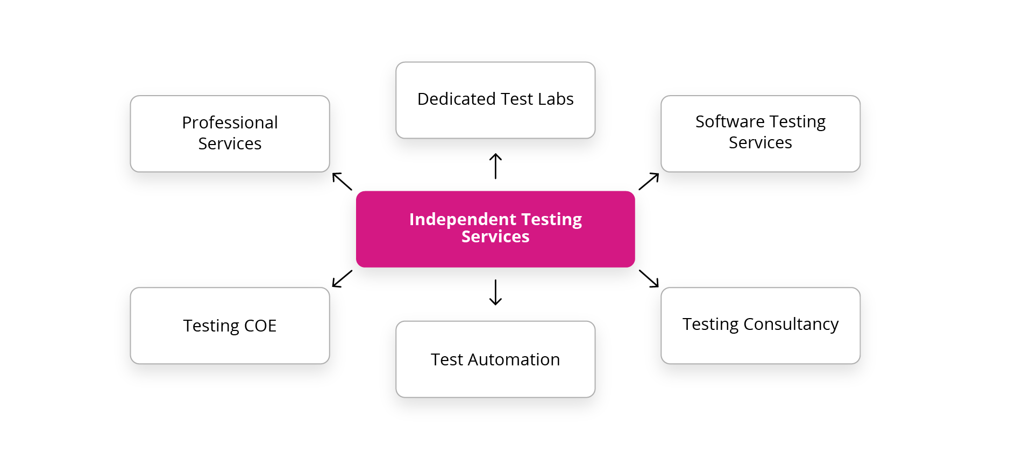
NEED OF INDEPENDENT TESTING
There are few needs of independent testing. They are:
1.Improved Software Quality
2.Experienced and Skilled Manpower
3. Lower Life Cycle Costs
4. Reduced Time to Market
5. Flexibility

Slide 26
1.Improved Software Quality :
One of the top benefits of outsourcing testing to independent testing organizations is improved software quality. Independent testing teams engage in a bias-free procedure and make sure that the product is developed according to customer requirements and meets the desired objectives while maintaining high quality.
2. Experienced and Skilled Manpower :
Independent testing organizations have experienced and skilled manpower to carry out testing activities in the best possible manner. They hire the best of talent across various testing domains like automation testing, manual testing, load testing, security testing, etc.
3. Lower Life Cycle Costs :
Organizations that employ independent testers can focus exclusively on quality and adherence to requirements and maintainability and scalability to address future needs. This ensures low failure rates and reduced maintenance costs. Rigorous testing cycles for both functional and non-functional aspects like performance and stress handling is covered.

Slide 27
4. Reduced Time to Market :
There is a reduced and improved time to market for organizations having an independent testing practice. Access to expertise in test automation skills ensures faster testing cycles. Predictability to testing efforts ensures adherence to timelines. Optimized staffing ensures effective handling of dynamic requirements.
5. Flexibility :
We are living in a fast-paced world and we need to be flexible in order to keep up with the pace. You can opt for automation testing or manual testing based on organizational needs. You can easily switch between manual and automation testing as independent testing organizations have the best of talent and expertise to do so.

Slide 28

ACTIVITIES IN FUNDAMENTAL TEST PROCESS

Slide 29
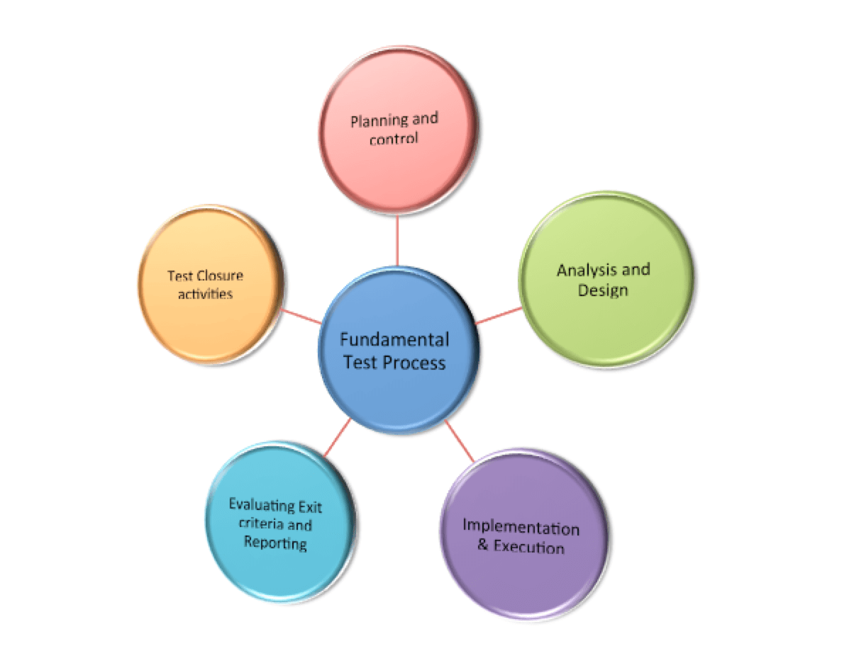
ACTIVITIES IN FUNDAMENTAL TEST PROCESS
The activities of testing can be divided into the following basic steps:
Planning and Control
Analysis and Design
Implementation and Execution
Evaluating exit criteria and Reporting
Test Closure activities

Slide 30
1) Planning and Control
Test Planning : Test planning involves producing a document that describes an overall approach and test objectives. It involves reviewing the test basis, identifying the test conditions based on analysis of test items, writing test cases and Designing the test environment. Completion or exit criteria must be specified so that we know when testing (at any stage) is complete.
Purpose
To determine the scope and risks and identify the objectives of testing.
To determine the required test resources like people, test environments etc.
To schedule test analysis and design tasks, test implementation, execution and evaluation.
Control This is the activity of comparing actual progress against the plan, and reporting the status, including deviations from the plan. It involves taking actions necessary to meet the mission and objectives of the project.

Slide 31
2) Analysis and Design
Test analysis and Test Design has the following major tasks:
To review the test basis. The test basis is the information on which test cases are based, such as requirements, design specifications, product risk analysis, architecture and interfaces
To identify test conditions
To design the tests
To design the test environment set-up and identify the required infrastructure and tools
3) Implementation and Execution
Test execution involves actually running the specified test on a computer system either manually or by using an automated test tool. It is a Fundamental Test Process in which actual work is done.
Test implementation has the following major task:
To develop and prioritize test cases by using techniques and create test data for those tests.
To create test suites from the test cases for efficient test execution. Test suite is a collection of test cases that are used to test a software program
To re-execute the tests that previously failed in order to confirm a fix.
To log the outcome of the test execution. A test log is the status of the test case (pass/fail).
To compare actual results with expected results.

Slide 32
4) Evaluating Exit criteria and Reporting
Evaluating exit criteria is a process defining when to stop testing. It depends on coverage of code, functionality or risk. Basically it also depends on business risk, cost and time and vary from project to project. Exit criteria come into picture, when:
Maximum test cases are executed with certain pass percentage
Bug rate falls below certain level
When we achieve the deadlines
Evaluating exit criteria has the following major tasks:
To assess if more test are needed or if the exit criteria specified should be changed
To write a test summary report for stakeholders

Slide 33
5) Test Closure activities:
Test closure activities are done when software is ready to be delivered. The testing can be closed for the other reasons also like:
When a project is cancelled
When some target is achieved
When a maintenance release or update is done
Test closure activities have the following major tasks:
To check which planned deliverables are actually delivered and to ensure that all incident reports have been resolved
To finalize and archive testware such as scripts, test environments, etc. for later reuse
To handover the testware to the maintenance organization. They will give support to the software
To evaluate how the testing went and learn lessons for future releases and projects

Slide 34

ATTRIBUTES OF A GOOD TESTER

Slide 35
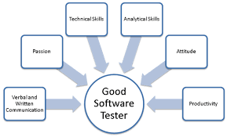
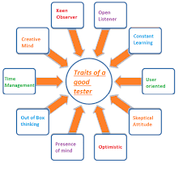
ATTRIBUTES OF A GOOD TESTER
These are the good tester attributes:
Excellent Communication.
Quick and Continuous Learning.
Strong Analytical Skills.
Creative.
Wise Time Management.
Technical Tools and Technical Knowledge.
Automation Proficiency.
DevOps Awareness.
Strong logical testing skills
Powerful analytical testing skills
Ability to work independently

Slide 36
PSYCHOLOGY OF TESTING

Slide 37


PSYCHOLOGY OF TESTING
Software development, including software testing, involves human beings.
Therefore, human psychology has important effect on software testing.
The three sections of the psychology of testing are:
The mindset of Developers and Testers.
Communication in a Constructive Manner.
Test Independence.

Slide 38

CODE OF ETHICS FOR TESTER

Slide 39

CODE OF ETHICS FOR TESTER
The various code of ethics are:
1.Public
2.Client & Employer
3.Product
4.Judgement
5.Management
6.Profession

Slide 40
The various code of ethics are:
Public: During the process of software development and testing, the public interest and benefit should be considered before corporate and personal gain. They should consistently act in the interest of the public.
Client & Employer: Apart from public interest, the testers should consider the interest of their client and employer while conducting tests on the software. They should act according to the requirements of their clients and should fulfill all their needs.
Product: The most important factor that needs consideration during the process of software testing is the product itself. The testers should perform their tasks while ensuring that the deliverable is of best quality and has exceptional effectiveness. Also, make sure that all deliverables on the product are in compliance with the stated standards.
Judgement: The testes should maintain integrity and independence while making judgments regarding the process of testing or any other aspects related to it.
Management: Here, the team managers and leads should take the responsibility and ethical steps to manage the process of software testing, development, and maintenance. This will help them avoid any confusion as well as allow them to test each component of the software accurately.
Profession: The team of testers should follow the set f values, principles, and standards and advance the integrity of their profession.

Slide 41
LIMITATIONS OF SOFTWARE TESTING

Slide 42

LIMITATIONS OF SOFTWARE TESTING
Exhaustive (total) testing is impossible in present scenario.
Time and budget constraints normally require very careful planning of the testing effort.
Compromise between thoroughness and budget.
Test results are used to make business decisions for release dates.
Even if you do find the last bug, you’ll never know it
You will run out of time before you run out of test cases
You cannot test every path
You cannot test every valid input
You cannot test every invalid input

Slide 43


